Slide 1
UPL Project Name
HCPF Site Visit
(Date)

Slide 2
About Us
Insert headshot and short bio of key project personnel

Slide 3
Project Information
Items to include:
Background, rationale, outcome goals
Clinic location where activities are taking place (e.g. Children’s Hospital Colorado Special Care Clinic, Anschutz Internal Medicine)
What UPL funding supports (High Level - ex. workforce, clinical capacity, etc.)
What year the project is on (Year 1, Year 2)

Slide 4
Key Accomplishments & Highlights
Add data to show project accomplishments, with a particular focus on data that shows
increased Medicaid volume to primary or specialty care
expansion of services available to Medicaid patients
Telehealth activity
Rural/Frontier outreach or services provided
Improvement in quality of care provided to Medicaid patients
Include maps, bar graphs, line charts, etc to visualize the data in a compelling way!

Slide 5
Success Stories
Add patient/provider testimonials or other qualitative story
Show the human impact of this funding on Medicaid members

Slide 6
FY 23 & 24 Enhancements and Outlook
Include upcoming milestones for your project in FY23 and FY24 (e.g. operational or data reporting enhancements, additional outreach to Medicaid patients, telehealth initiatives, expansion of services, etc)

Slide 7
Community Engagement
Discuss community engagement strategy, partners, successes, barriers, next steps, etc.
Is there support from CUSOM or the Department to help enhance this engagement?

Slide 8
FY24 Future Planning
What kind of support do you and your team need?
Are there challenges you are currently facing?
Do you have the administrative and staff capacity to complete goals?
How do you or plan to measure success?
What about access to care success?

Slide 9
Discussion
Add any specific items you want to ask HCPF about or bring to HCPF’s attention. Could include things like reimbursement, data sharing, policy changes.

Slide 10
Thank you!
Questions?

Slide 11
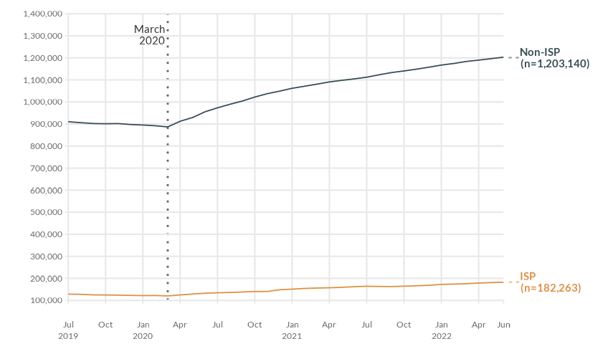
Member Attribution
Notes:
Month Range: July 2019 – June 2022 (3 Fiscal Years)
ISP vs non-ISP unique members attributed per month

Slide 12
Member Attribution
Notes:
Month Range: July 2019 – June 2022 (3 Fiscal Years)
ISP vs non-ISP unique members attributed per month

